Slide 1
Applications of GANs for Time Series Analysis
Generative Learning Bootcamp 2020
20 October 2020

Slide 2
Outline
Fundamental of Time Series Analysis
GAN Application: Data Augmentation
GAN Application: Forecasting
GAN Application: Anomaly Detection

Slide 3
Fundamental of Time Series Analysis

Slide 4
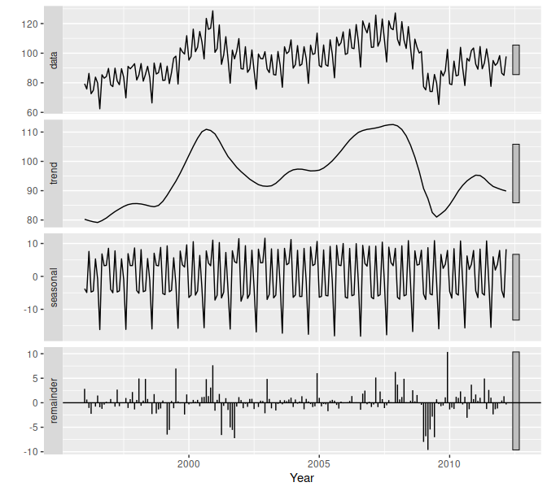

Definition
A time series (TS) is simply a series of data points ordered in time:
Important concepts in TS analysis:
Trend = long-term increase or decrease
Seasonality = periodic fluctuation
Irregular/remainder/residual = non-trend & non-seasonality component
Stationary = a condition where the joint probability distribution between 1) a set of observations, and 2) a time-shifted set of observations, is equal:
It means the way it changes itself does not change over time = predictable
This is the main goal of TS modelling

Slide 5
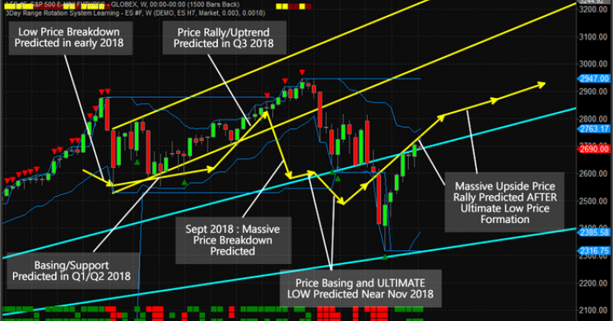
Applications
Some applications of TS analysis:
Weather and climate prediction
Flood risk assessment
Seismic hazard prediction
Availability of renewable energy resources prediction
Economic and financial risk management
Health care
Predictive and preventative medicine
…

Slide 6
GAN Application: Data Augmentation

Slide 7
Reference
Cristóbal Esteban, Stephanie L. Hyland, & Gunnar Rätsch. (2017). Real-valued (Medical) Time Series Generation with Recurrent Conditional GANs.
Zinan Lin, Alankar Jain, Chen Wang, Giulia Fanti, & Vyas Sekar. (2020). Using GANs for Sharing Networked Time Series Data: Challenges, Initial Promise, and Open Questions.
aSnow, Derek. (2020). MTSS-GAN: Multivariate Time Series Simulation Generative Adversarial Networks.

Slide 8
Problem
Limited data access is a longstanding barrier to data-driven research and development
Highly sensitive data (Privacy concerned)
High data collection cost
Even if it is available, time series data often non-stationary
Which means only small sample sets of data with the same joint probability distribution available
E.g. very unlikely event (like periods of unusually high volatility) are normally underrepresented
= Not generalize overtime, which raise constant need to update the model
Question: Could GAN produced alternative realistic time series that share the same statistical properties of the original one?
Generate generalizable synthetic datasets,
As many as we need,
With minimum human expertise involved

Slide 9
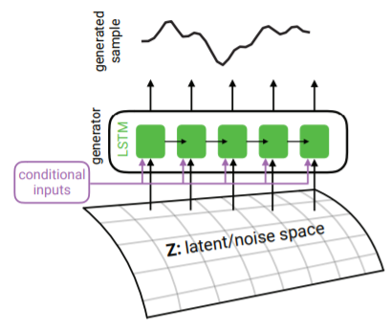

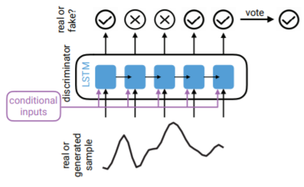
Approach
Paper 1: Real-valued (Medical) Time Series Generation with Recurrent Conditional GANs (2017)
Using Recurrent GAN to generate sequences of real-valued data
Using Recurrent Conditional GAN to generate sequences of real-valued data, subject to some conditional inputs
The discriminator is trained to minimize the average negative cross-entropy between its predictions per time-step and the labels of the sequence:
The generator is trained to minimize the average negative cross-entropy between the discriminator’s predictions on generated sequences and the ‘true’ label
The objective for the generator is to ‘trick’ the discriminator into classifying its outputs as true
Generator:
Discriminator:

Slide 10
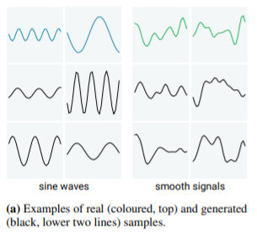
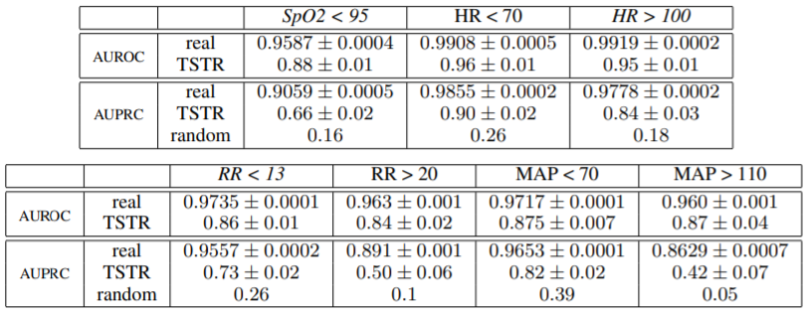
Approach
Paper 1: Real-valued (Medical) Time Series Generation with Recurrent Conditional GANs (2017)
For evaluation, they use “Maximum Mean Discrepancy”:
MMD asks if two sets of samples (generated & true data) were generated by the same distribution
Thus, GAN model is considered successful if it implicitly learns the distribution of the true data
Then, they use the generated data for classification task
Train on Synthetic data, Test on Real data (TSTR)
Result: RCGANs can generate time series data useful for supervised training
With only minor degradation in performance on real test data

Slide 11
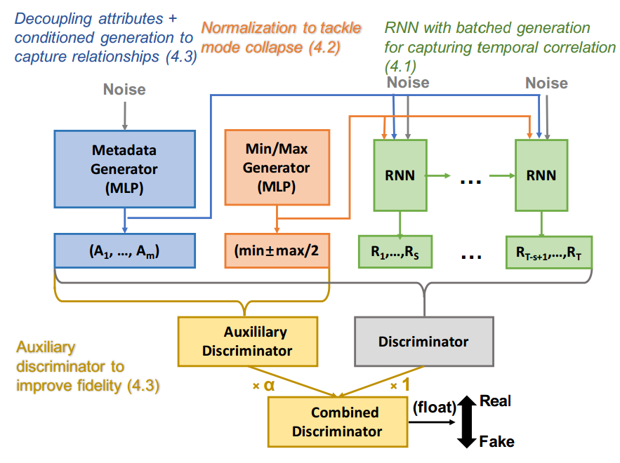
Approach
Paper 2: Using GANs for Sharing Networked Time Series Data: Challenges, Initial Promise, and Open Questions (2020)
Decoupling attributes & conditioned generation to capture the relationship between metadata & measurements
Normalization to tackle mode collapse
RNN with batched generation to capture temporal correlation
However, when the total dimension of samples is large, a single discriminator will have a hard time to judge
Solution = Auxiliary Discriminator, which discriminates metadata only
This enable Metadata & Min/Max generator to effectively learns from auxiliary discriminator to generate high-fidelity metadata
Combined discriminator will enable the model to learn both metadata & measurements

Slide 12
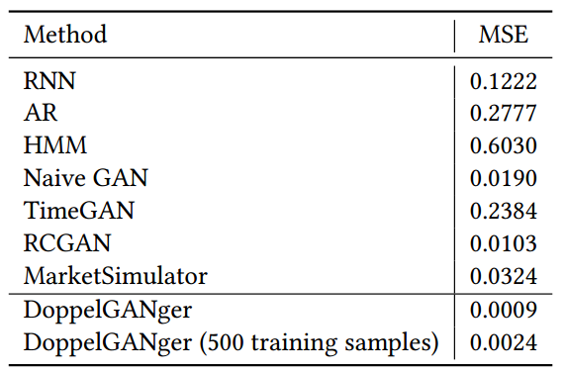
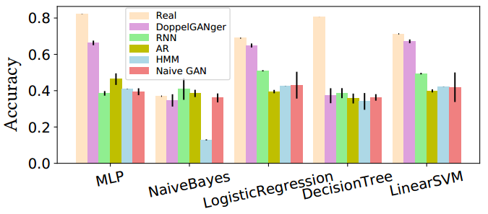
Approach
Paper 2: Using GANs for Sharing Networked Time Series Data: Challenges, Initial Promise, and Open Questions (2020)
For evaluation, they use a combination of qualitative and quantitative metrics to determine:
How closely a statistic of the generated data matches the real data = Autocorrelation
The similarity between generated & real data = MSE of Autocorrelation
Then, they use the generated data for forecasting task
Train on Synthetic data, Test on Real data (TSTR)
Result: DoppelGANger achieves up to 43% better fidelity than baseline models

Slide 13
GAN Application: Forecasting

Slide 14
Reference
Xingyu Zhou, Zhisong Pan, Guyu Hu, Siqi Tang, Cheng Zhao, Stock Market Prediction on High-Frequency Data Using Generative Adversarial Nets, Mathematical Problems in Engineering, vol. 2018, Article ID 4907423, 11 pages, 2018
A. Koochali, P. Schichtel, A. Dengel, & S. Ahmed (2019). Probabilistic Forecasting of Sensory Data With Generative Adversarial Networks – ForGAN. IEEE Access, 7, 63868-63880.
Alireza Koochali, Andreas Dengel, & Sheraz Ahmed. (2020). If You Like It, GAN It: Probabilistic Multivariate Times Series Forecast With GAN.

Slide 15
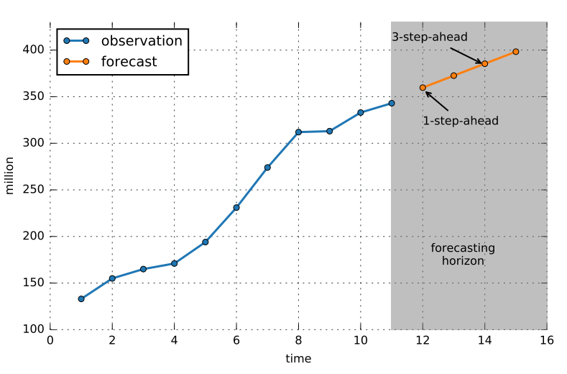
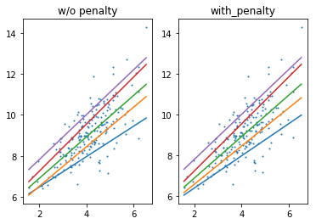
Problem
Time series forecasting is one of the challenging problems for humankind
How to obtain the predictive probability distribution over future quantities?
Most forecasting methods focus on only one designated quantity of the response distribution, namely the mean
They do not include the fluctuations around the mean value
To solve this issue, we use probabilistic forecasting
This allows us to quantify the variance in a prediction
Challenges:
Selecting a prior distribution (Bayesian method)
Quantile crossing
Question: Could GAN be used for probabilistic forecasting and address challenges around it?

Slide 16
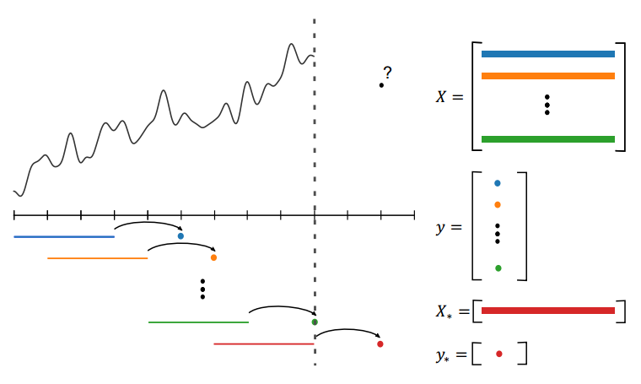

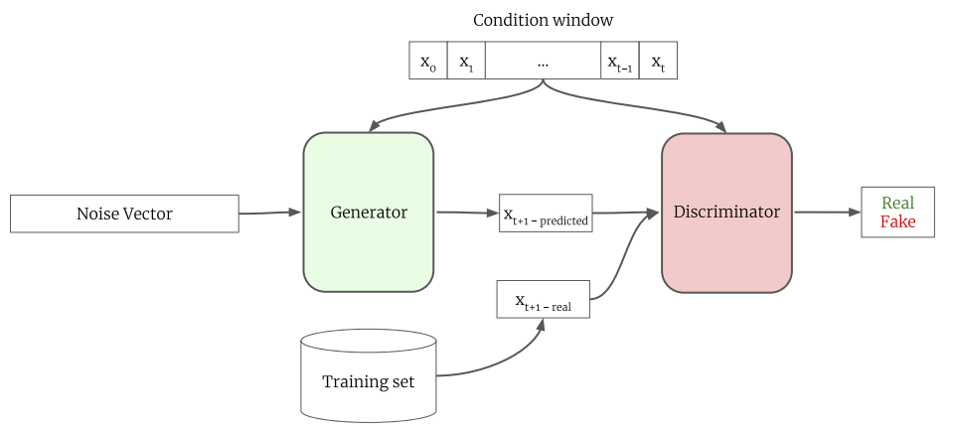
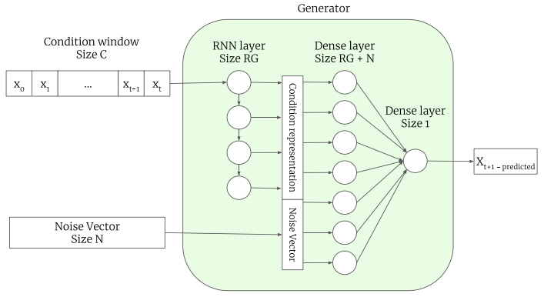
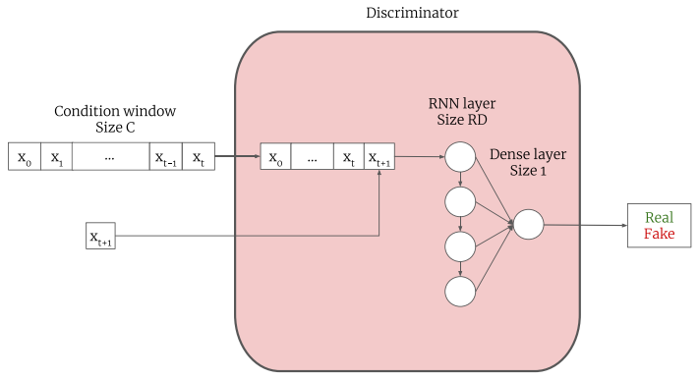
Approach
Paper 1: Probabilistic Forecasting of Sensory Data With Generative Adversarial Networks – ForGAN (2019)
Generator = Generate one-step-ahead prediction
Discriminator = Distinguish between one-step-ahead prediction value and actual value
Loss function:
Able to learn the full probability distribution of X_{t+1}
Time Series Embedding

Slide 17
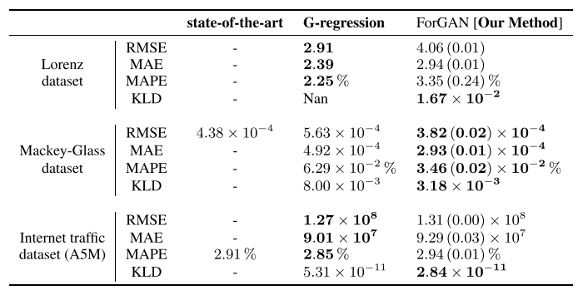
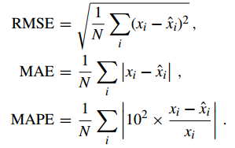
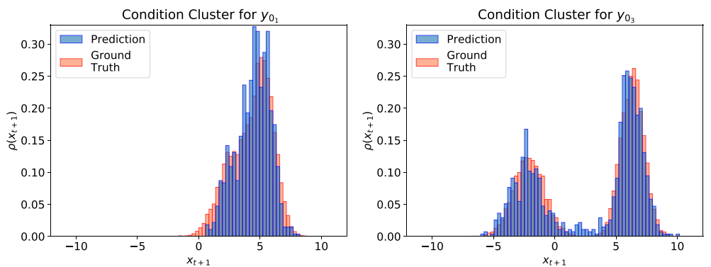

Approach
Paper 1: Probabilistic Forecasting of Sensory Data With Generative Adversarial Networks – ForGAN (2019)
For evaluation,
They use 3 metrics for point-wise prediction:
They use KL Divergence for distribution similarity:
Result: Outstanding
Could generate one-step-ahead prediction with closely-similar distribution with the ground truth

Slide 18



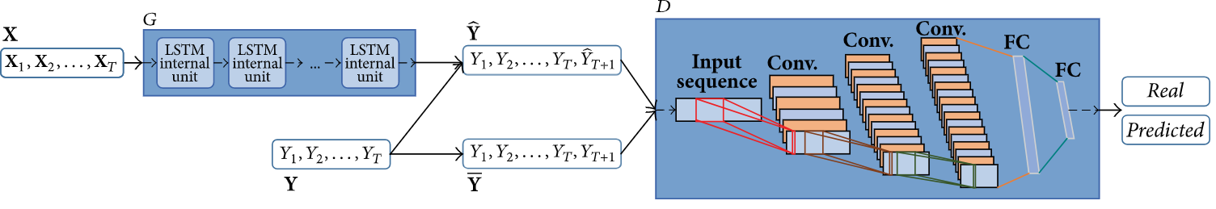
Approach
Paper 2: Stock Market Prediction on High-Frequency Data Using Generative Adversarial Nets (2018)
Loss function
Sigmoid Cross-Entropy & Forecast error loss function:
Additional loss function = Direction prediction loss function:
Combined loss:
(Make the predicted direction as good as the actual direction)
(Confuse Discriminator as hard as you can)
(Make the predicted value as good as the actual value)

Slide 19
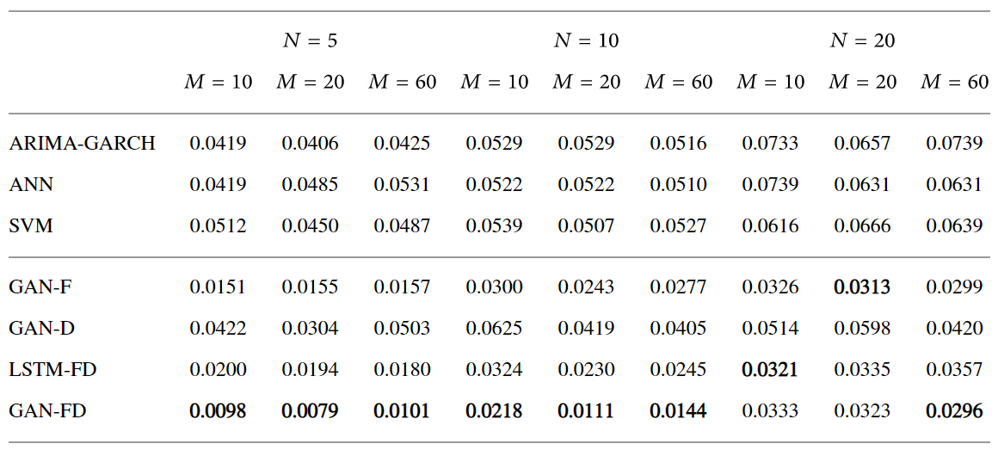
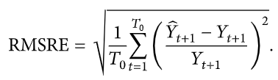

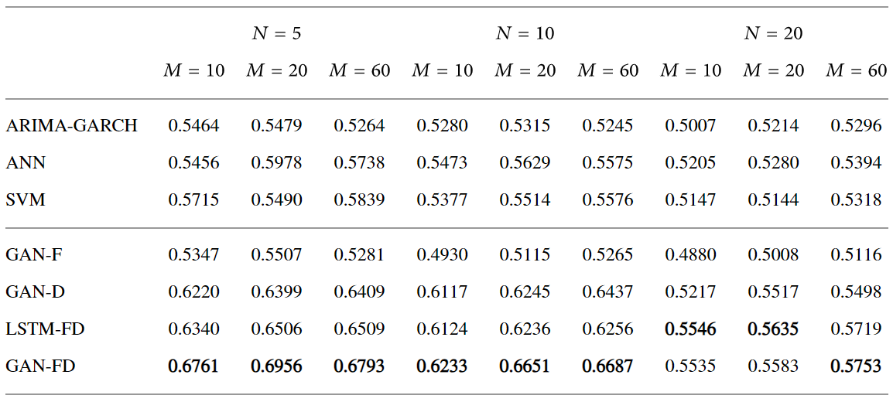

Approach
Paper 2: Stock Market Prediction on High-Frequency Data Using Generative Adversarial Nets (2018)
For evaluation, they use:
RMSRE for measuring the forecasting performance:
Direction Prediction Accuracy (DPA) for measuring the accuracy relating to the series trend:
Result: superior to other benchmark method
RMSRE
DPA
where

Slide 20
GAN Application: Anomaly Detection

Slide 21
Reference
Li, S.K. (2019). MAD-GAN: Multivariate Anomaly Detection for Time Series Data with Generative Adversarial Networks. In Artificial Neural Networks and Machine Learning – ICANN 2019: Text and Time Series (pp. 703–716). Springer International Publishing.
Dan Li, Dacheng Chen, Jonathan Goh, & See-kiong Ng. (2019). Anomaly Detection with Generative Adversarial Networks for Multivariate Time Series.
Md Abul Bashar, & Richi Nayak. (2020). TAnoGAN: Time Series Anomaly Detection with Generative Adversarial Networks.
Niu Z, Yu K, Wu X. (2020). LSTM-Based VAE-GAN for Time-Series Anomaly Detection. Sensors. 20(13):3738.

Slide 22
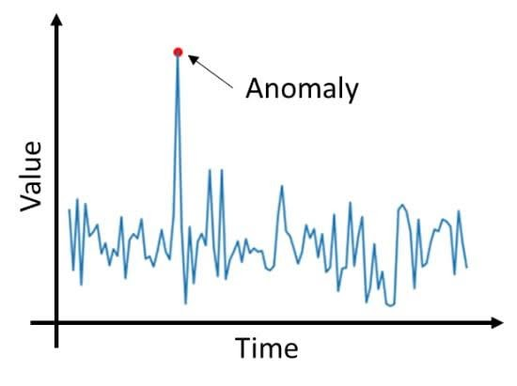
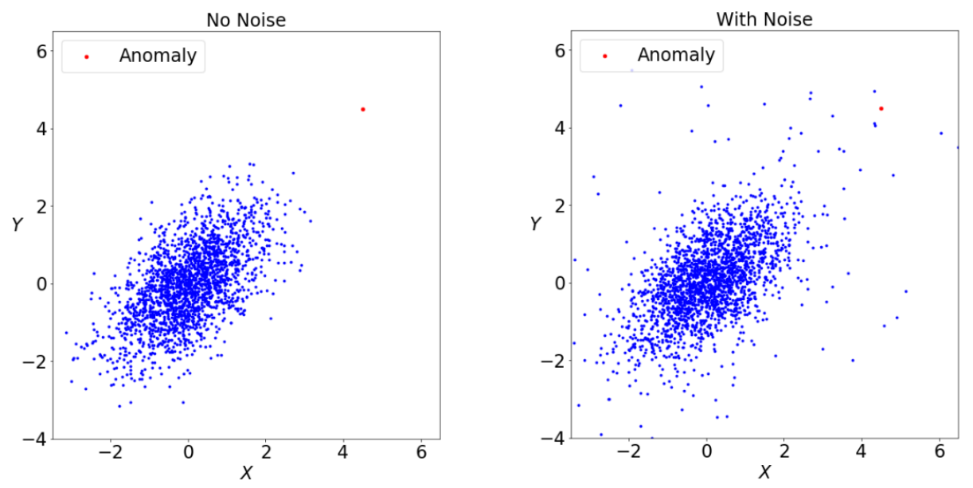
Problem
An anomaly is an observation or a sequence of observations which deviates remarkably from the general distribution of data
The set of the anomalies form a very small part of the dataset (usually <5%)
Anomaly detection = detect rare data points that deviate remarkably from the general distribution of the dataset
Noise ≠ Anomaly >> Detecting noise trigger false alarm
Problem with current implementation:
Lack of labeled data
Unable to capture inter-dependencies of multivariate time series
Inadequate for highly-dynamic nature of the systems (non-stationary)
Question: Could GAN be used for unsupervised anomaly detection and address challenges around it?

Slide 23
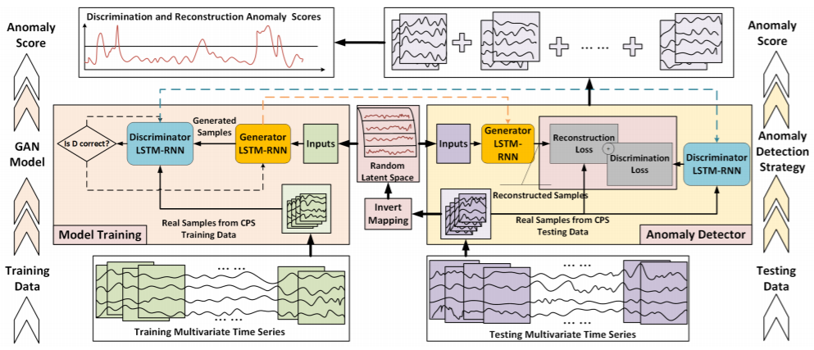
Approach
Paper 1: MAD-GAN: Multivariate Anomaly Detection for Time Series Data with Generative Adversarial Networks (2019)
Discriminator tries to distinguish the “fake” data from the “real” data
Thus, in order to fool Discriminator, Generator is trained to be able to generate the “real” data
Discriminator will become sensitive to anomaly >> will be used to classify the anomaly
Generator will be able to generate “normal” data >> will be used to calculate the similarity between generated and real data
Combination of both loss = anomaly criteria

Slide 24
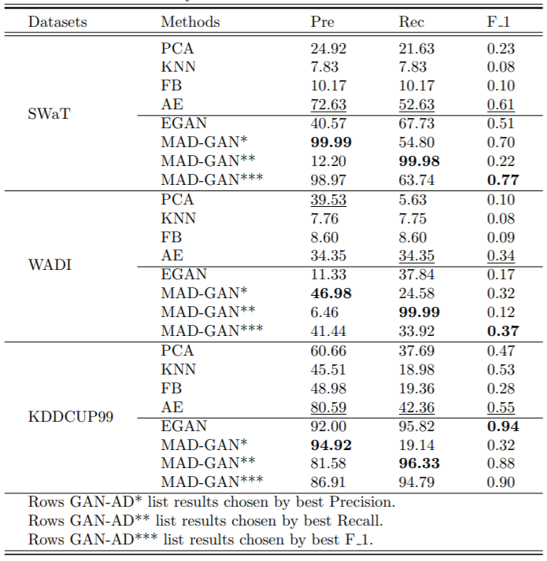
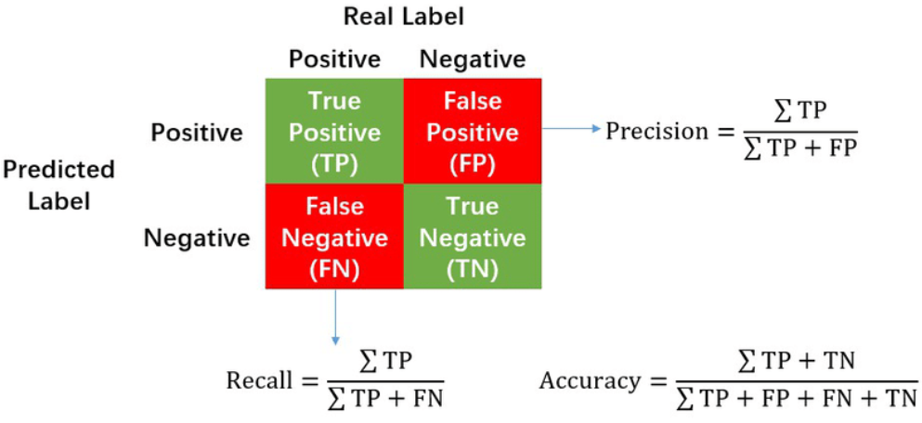
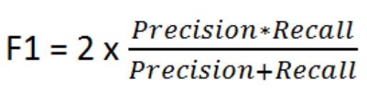
Approach
Paper 1: MAD-GAN: Multivariate Anomaly Detection for Time Series Data with Generative Adversarial Networks (2019)
For evaluation, they use Precision, Recall, and F1:
Result: superior to other benchmark method

Slide 25
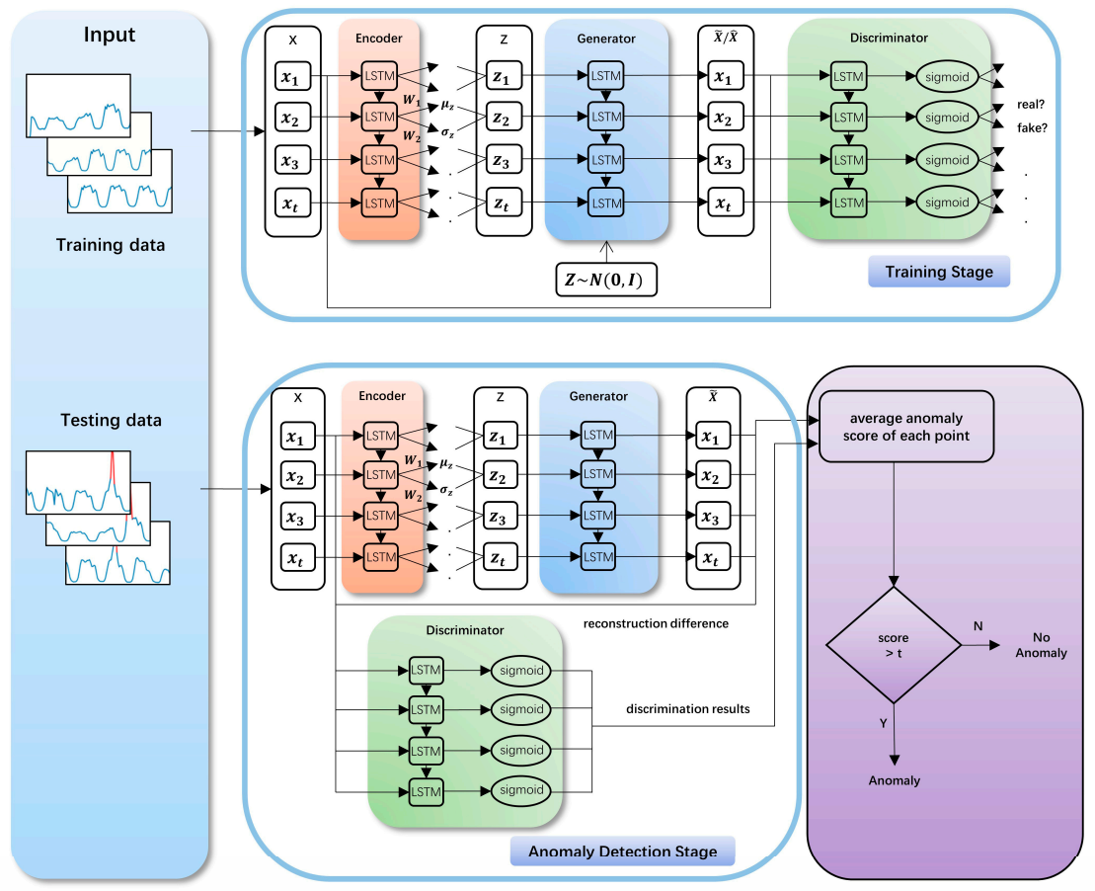


Approach
Paper 2: LSTM-Based VAE-GAN for Time-Series Anomaly Detection (2020)
Here, the encoder, the generator and the discriminator are jointly trained
Encoder = maps the input time series to the latent space:
Generator = reconstructs the input time series
Discriminator = judges anomalies
Because of joint train, the model does not need to calculate the best mapping from real-time space to the latent space at the anomaly detection stage
Hence, faster detection time

Slide 26
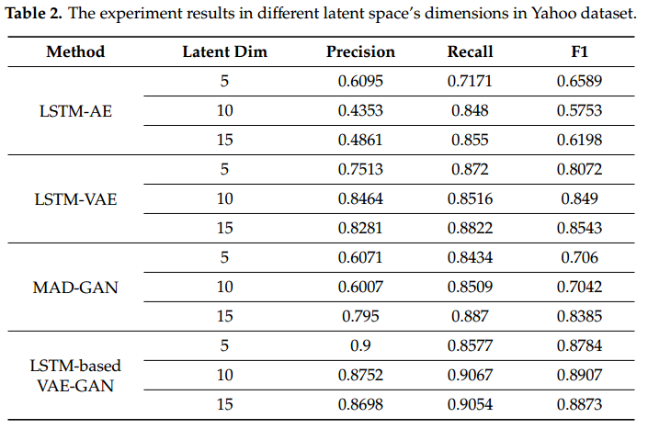
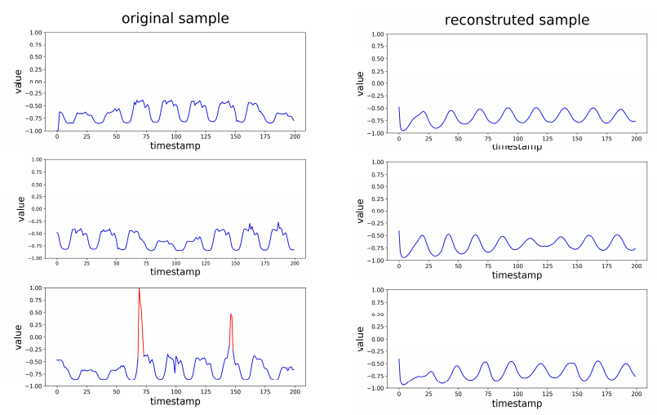
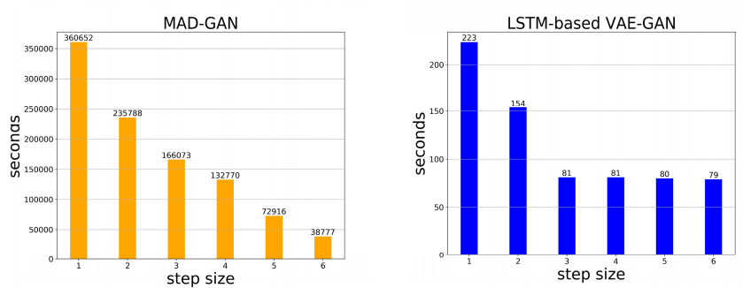
Approach
Paper 2: LSTM-Based VAE-GAN for Time-Series Anomaly Detection (2020)
Similar evaluation: Precision, Recall, F1
Result: Better score than MAD-GAN with faster inference time

Slide 27
If you can’t convince them, confuse them
-GAN, in a nutshell

Slide 28
THANK YOU

